Slide 1
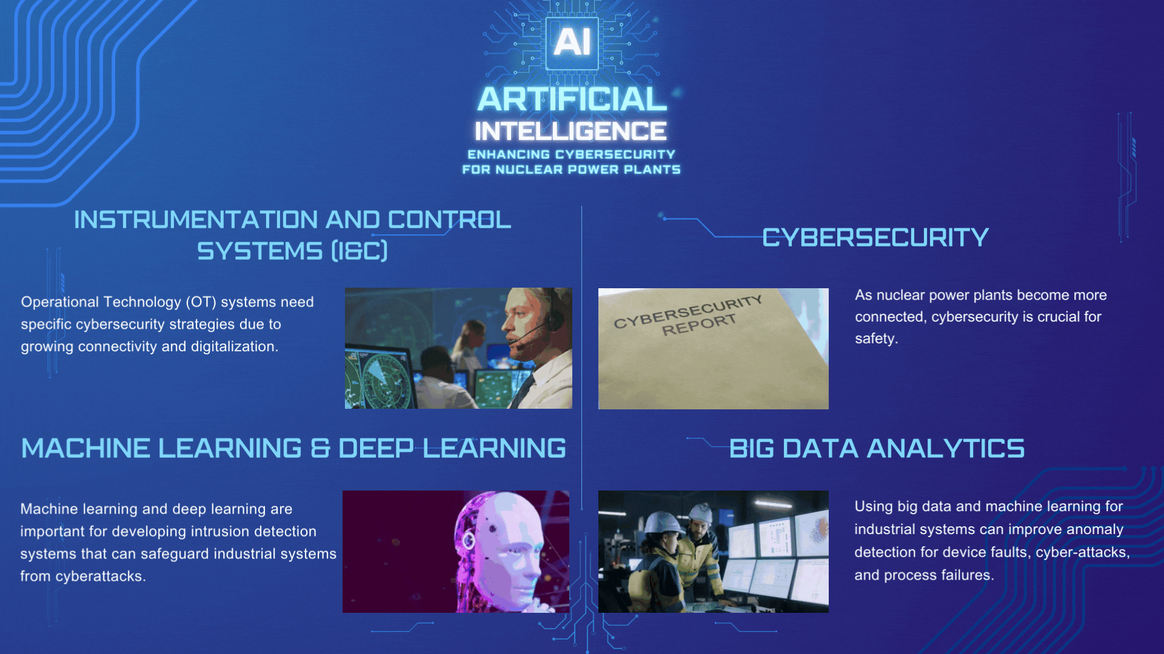

Slide 2
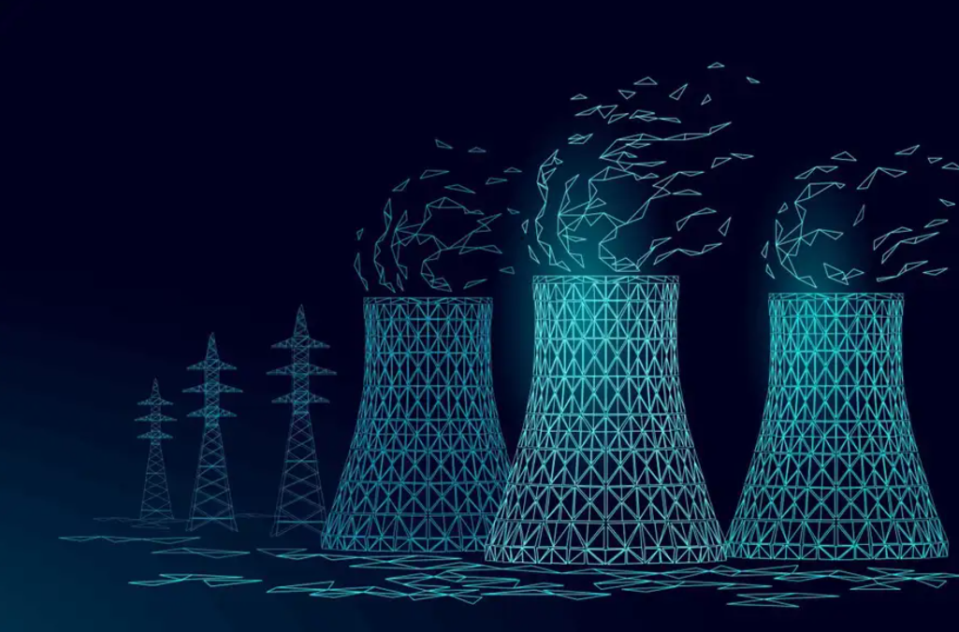
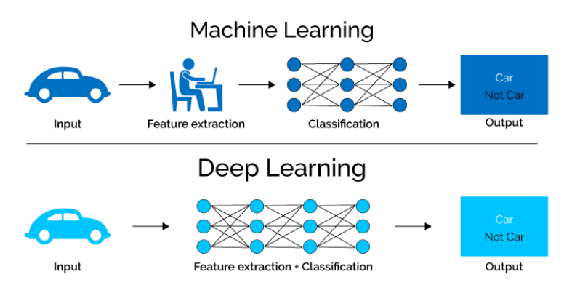
Gereklilikleri nükleer endüstride
Güvenlik, güvenilirlik, deterministik
Yanlış alarmlar ciddi sonuçlara yol açar
Yanlış alarmlar ekonomi için kötüdür
Yapay zekanın yeteneği?
Kara kutu: şeffaf olmayan, yorumlanamayan
Yapay zekanın sonuçlarına güven eksikliği
LuckyStep48 / Alamy. (2022, May 25). Nuclear power station cooling tower low poly. [Digital image]. Retrieved from https://www.newscientist.com/article/mg25433882-600-nuclear-power-can-help-us-reach-net-zero-but-what-is-its-true-cost/
Comparing deep learning with machine learning. Source: XenonStack
Notes:
How to build a trustworthy industrial AI
The answer is increasing
Explainability / Interpretability of AI
provide human-understandable explanations for the behavior of black-box AI
to ensure certain properties are guaranteed due to interpretability itself
the fundamental to the industrial AI applications

Slide 3

The requirements of
nuclear industry
Safety, reliability, deterministic
False negatives lead to serious consequences
False positives are bad for economics
The ability of artificial
Intelligence
Black box: non-transparent, un-interpretable
Lack of confidence in the results of AI
LuckyStep48 / Alamy. (2022, May 25). Nuclear power station cooling tower low poly. [Digital image]. Retrieved from https://www.newscientist.com/article/mg25433882-600-nuclear-power-can-help-us-reach-net-zero-but-what-is-its-true-cost/
Comparing deep learning with machine learning. Source: XenonStack
Notes:
How to build a trustworthy industrial AI
The answer is increasing
Explainability / Interpretability of AI
provide human-understandable explanations for the behavior of black-box AI
to ensure certain properties are guaranteed due to interpretability itself
the fundamental to the industrial AI applications

